Slide 1
The Two Babylons
The roman catholic church

Slide 2
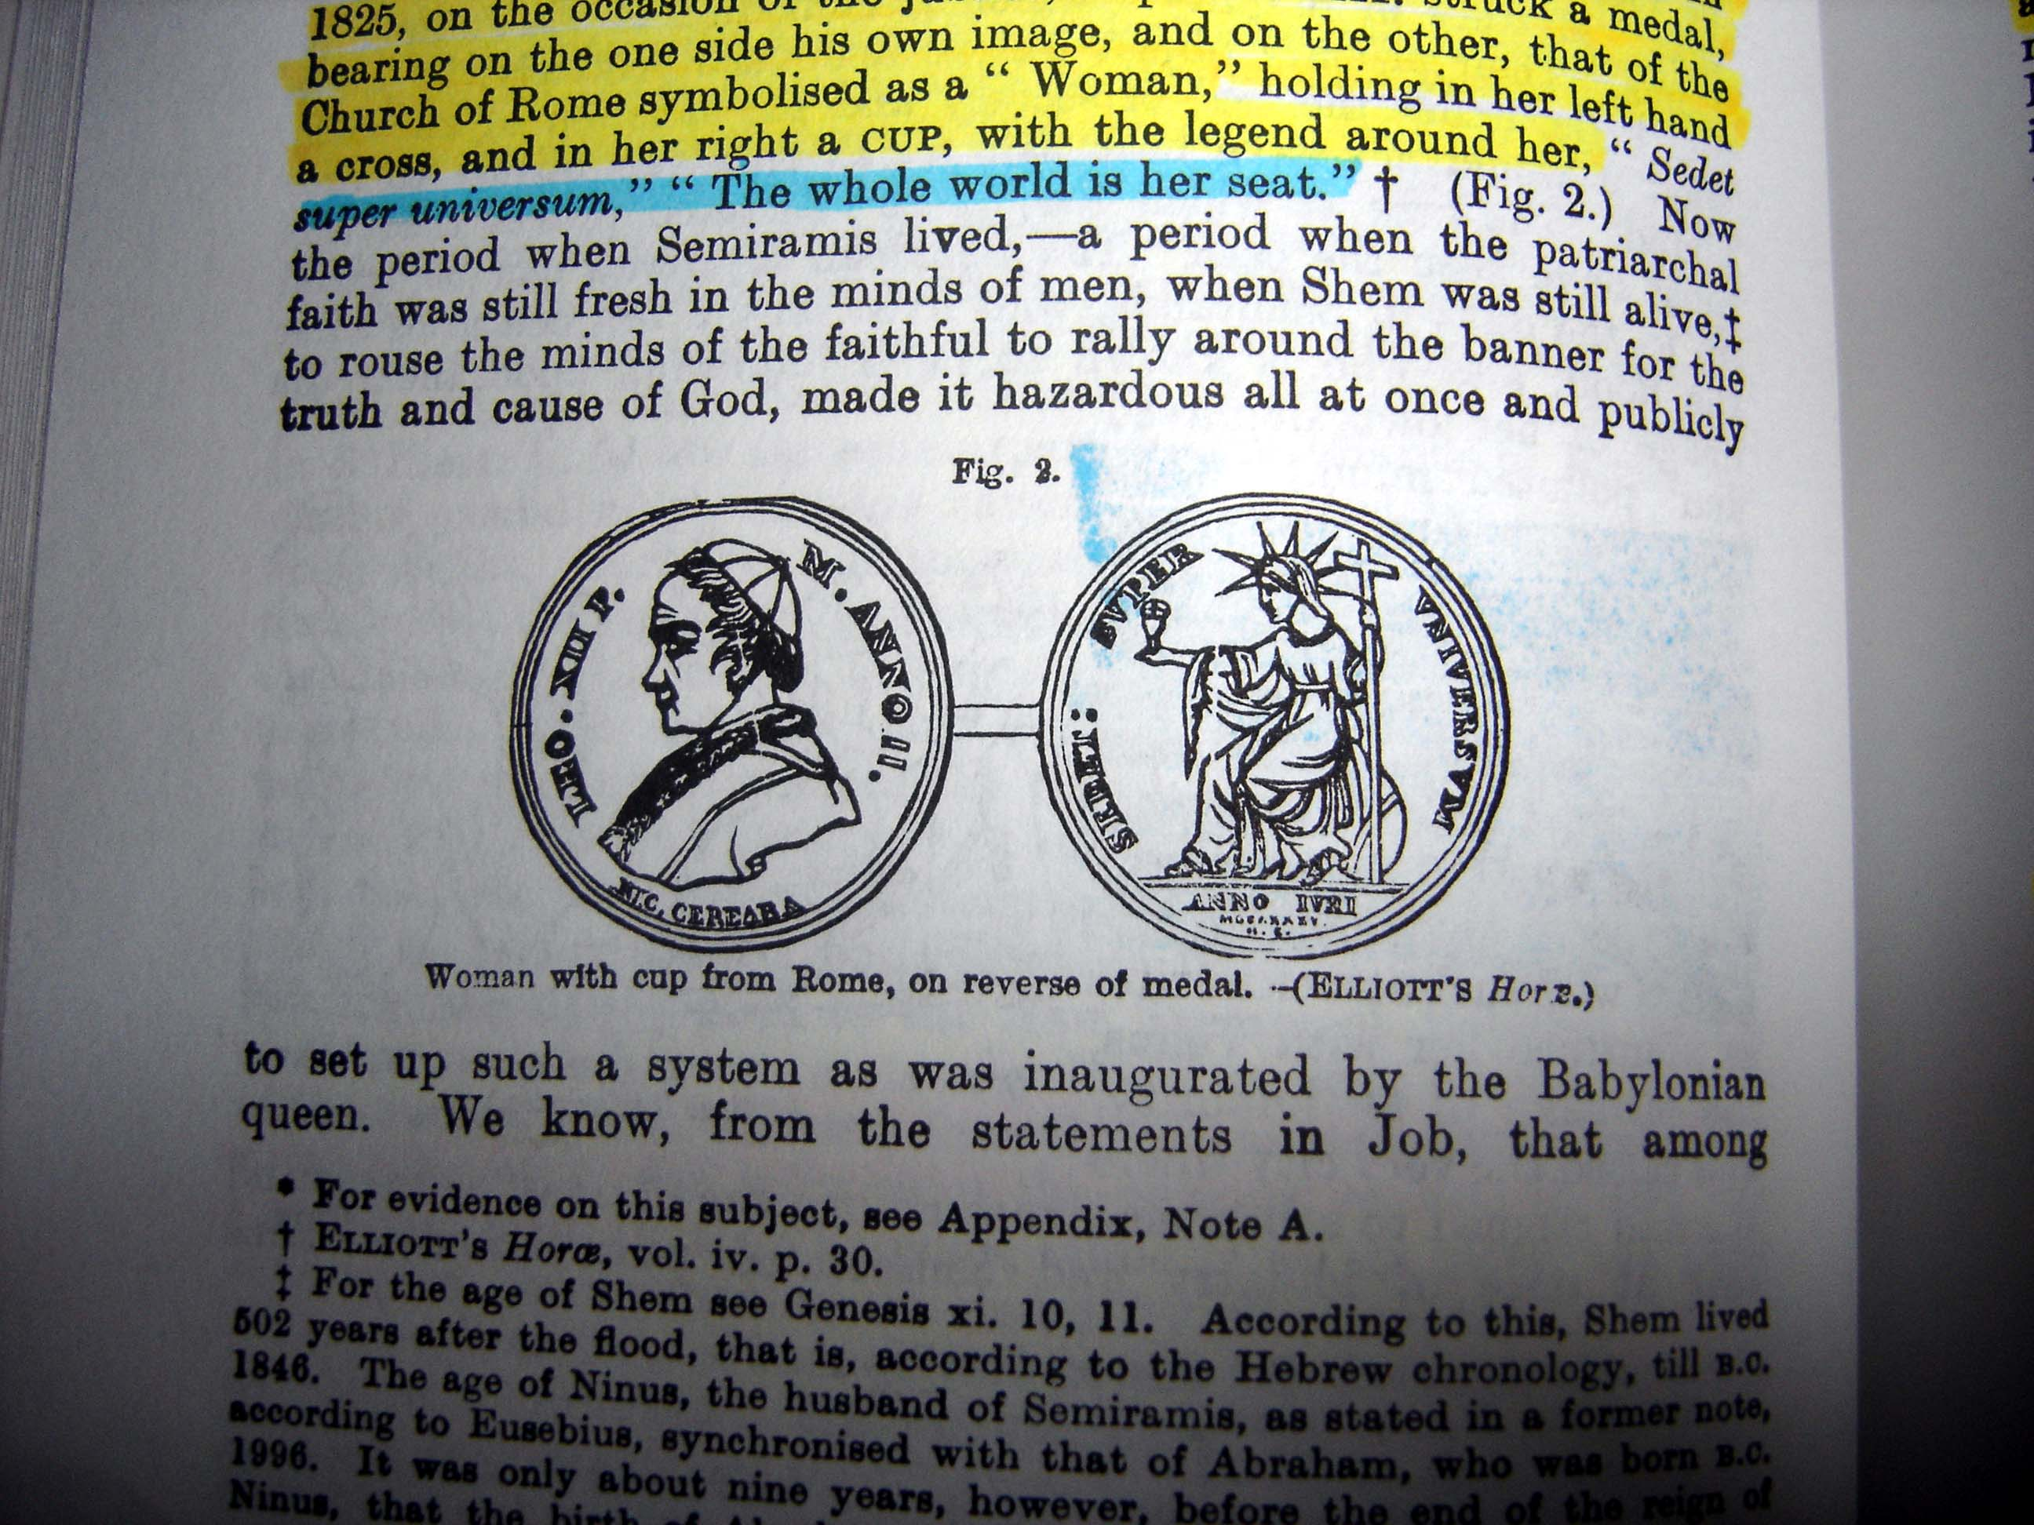
The whole world is her seat
The Church of Rome is symbolized as a “Woman” holding in her left hand a cross and in her right hand a cup

Slide 3
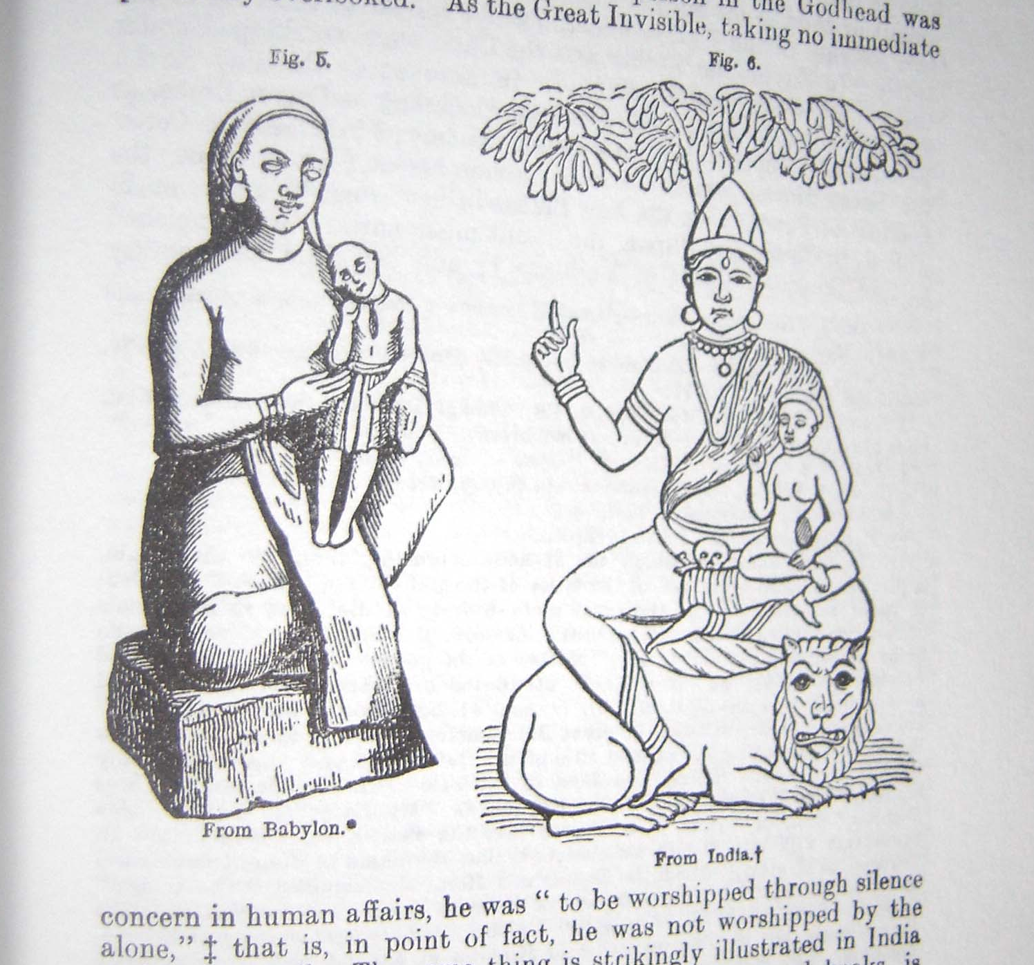
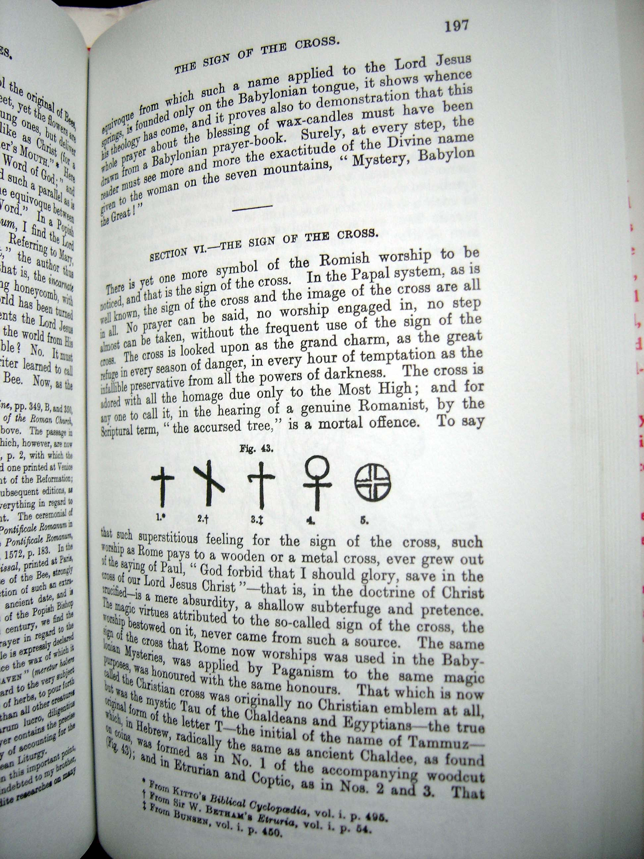
Pagan Roots
Mother and Infant worship is all around the world
Many catholic symbols are pagan in origin

Slide 4

What can you do with power point?
Add title and use outlines
  Media
    Pictures
    Clipart
Ready to use design templates
  Easy to use
  Easy to change without starting over

Slide 5


Slide 6
VIDEO
Mpeg and wma video clips

Slide 7
Pictures
You can use clip art or pictures
  Just have them in the slide or give them their own

Slide 8
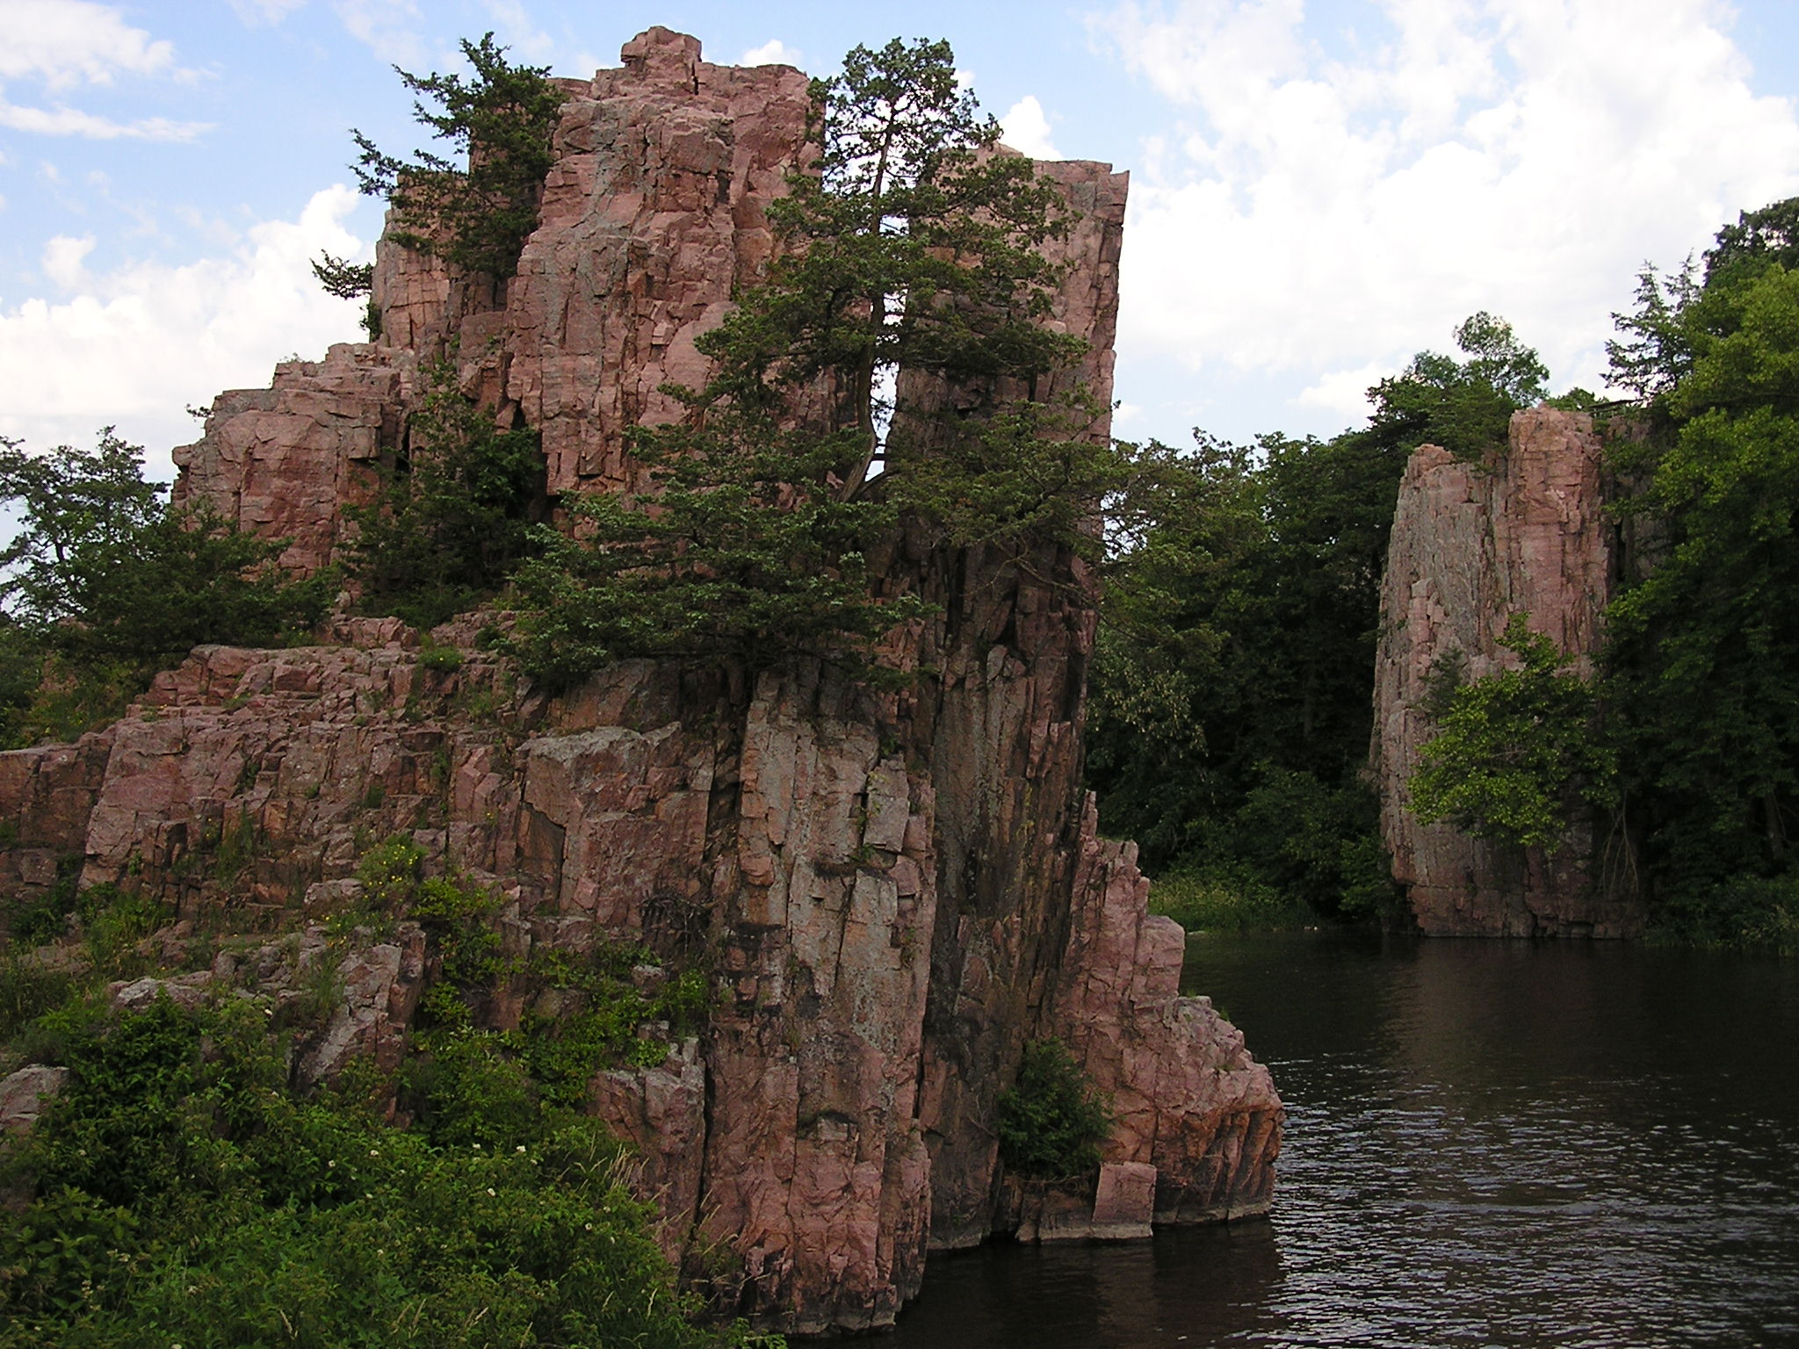

Slide 9


